Slide 1
WELL COME TO OUR PRESENTATION.
E-commerce.

Slide 2
Group Member:-
Name: MD Imran Hossain. ID: 132 – 15 – 2729
Name: Iftekhar Bin Hie. ID: 132 – 15 – 2760
Name: Dalia sultana Juthi. ID: 111-15-1278

Slide 3
Our Project:
Damudya industrial it service [ Dit ]
It’s a commercial it Business company Where we provide it related service and tarring.
Now we Need:-
-Publishing or Marketing.
- Communication with client.
-Well service.

Slide 4


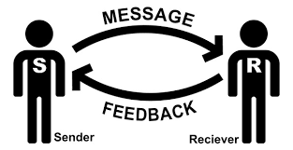
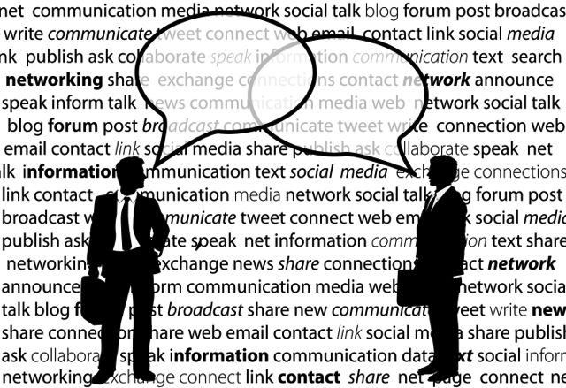
How can…..?

Slide 5
Solution with e-commerce…!!!
V \\\ \ \
communication
Business process sort Life cycle.
Online advertising
Selles
Product of Servic
Company
Success

Slide 6
Live project:
Click for the live show…

Slide 7
Benefit of using e-commerce:-
Saving time and money.
Well and fester communication system.
Easy every service and process.

Slide 8
Thank you…………

